Slide 1
Capstone Engagement
Assessment, Analysis, and Hardening of a Vulnerable System

Slide 2
Table of Contents
This document contains the following sections:
01
Network Topology
02
Red Team: Security Assessment
03
Blue Team: Log Analysis and Attack Characterization
Hardening: Proposed Alarms and Mitigation Strategies
04

Slide 3
Network Topology
‹#›

Slide 4
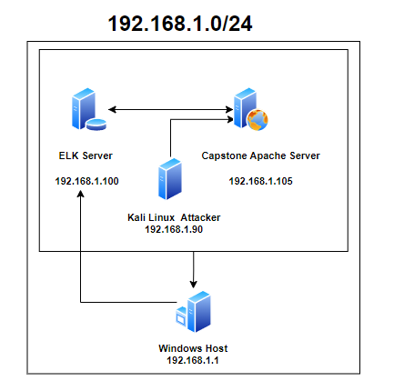
Network Topology
Network
Address Range: 192.168.1.0/24
Netmask:255.255.255.0
Gateway:192.168.1.1
Machines
IPv4: 192.168.1.105
OS: Linux Ubuntu
Hostname: Capstone
IPv4: 192.168.1.90
OS: Kali Linux
Hostname: Kali
IPv4: 192.168.1.100
OS: Linux
Hostname: ELK
IPv4: 192.168.1.1
OS: Windows 10
Hostname: ML-RefVm-684427

Slide 5

Red Team
Security Assessment
‹#›

Slide 6
Recon: Describing the Target
Nmap identified the following hosts on the network:
Hostname | IP Address | Role on Network
Windows Host Machine | 192.168.1.1 | Cloud Based Host Machine
Kali | 192.168.1.90 | Attacking Machine
Capstone | 192.168.1.105 | Target Machine
ELK Stack | 192.168.1.100 | Network Monitoring Machine With Kibana

Slide 7
Vulnerability Assessment
The assessment uncovered the following critical vulnerabilities in the target:
Vulnerability | Description | Impact
Brute Force - Password cracking | Simple passwords can be obtained by programs that guess all of the combinations | This allowed Ashton’s account to be compromised and the company secret folder accessed
CVE-2019-6579 Open Ports With public access Port 80 | Unsecured access to web client communication and messages | Execute system commands with administrative privileges.
Weak usernames | Using first names as usernames Can be easily found through social engineering | Gain access to accounts and easily sift through all files and folders
Weak Passwords | Simple password without any special characters or numbers | Can easily gain access the system

Slide 8
Vulnerability Assessment
The assessment uncovered the following critical vulnerabilities in the target:
Vulnerability | Description | Impact
WebDav Vulnerability | Unsecured access to web client communication and messages | Execute system commands with administrative privileges.
LFI Vulnerability | LFI allows access into confidential files on a site. | An LFI vulnerability allows attackers to gain access to sensitive credentials
All associates credentials found on other accounts | Keeping usernames and passwords in files | If a hacker gains access to the account they have all necessary information to access all accounts Making it easier for them
Root Access | Root can execute commands, add user and give permissions | Hackers having full access can damage your entire system and corrupt or delete everything

Slide 9
Vulnerability Assessment
The assessment uncovered the following critical vulnerabilities in the target:
Vulnerability | Description | Impact
Hashed Passwords | Hashed passwords are passwords easily cracked with online tools such as crackstation.net | Using the passwords you can easily get access to all information on the users account.
Open Ports | Multiple ports are open that are not needed. | Allows more openings from the network into the system.
Unauthorized File Upload | System allows files to be uploaded without verification. | Malicious scripts and malware can be uploaded and installed on the system.
Unsecured Memo’s | Internal memo’s being open to the public with sensitive information. | The memo found led the attacker to the hidden directory for internal use only.

Slide 10
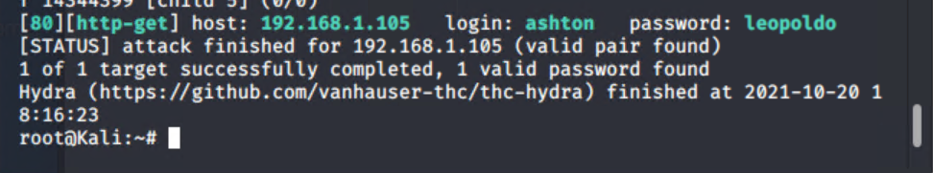
Exploitation: Brute Force
01
02
03
Tools & Processes
Browsing the company website one can access the password protected file inside the secret_folder that details how to access the companies webdav server and includes an easily decipherable password for the CEO, Ryan.
Achievements
Since this folder was only protected by password an application called hydra was able to determine the weak password.
Using this application we obtained Ashton’s Password
Proof of Concept
hydra -l ashton -P /usr/share/wordlists/rockyou.txt -s 80 -f -vV 192.168.1.105 http-get /company_folders/secret_folder

Slide 11
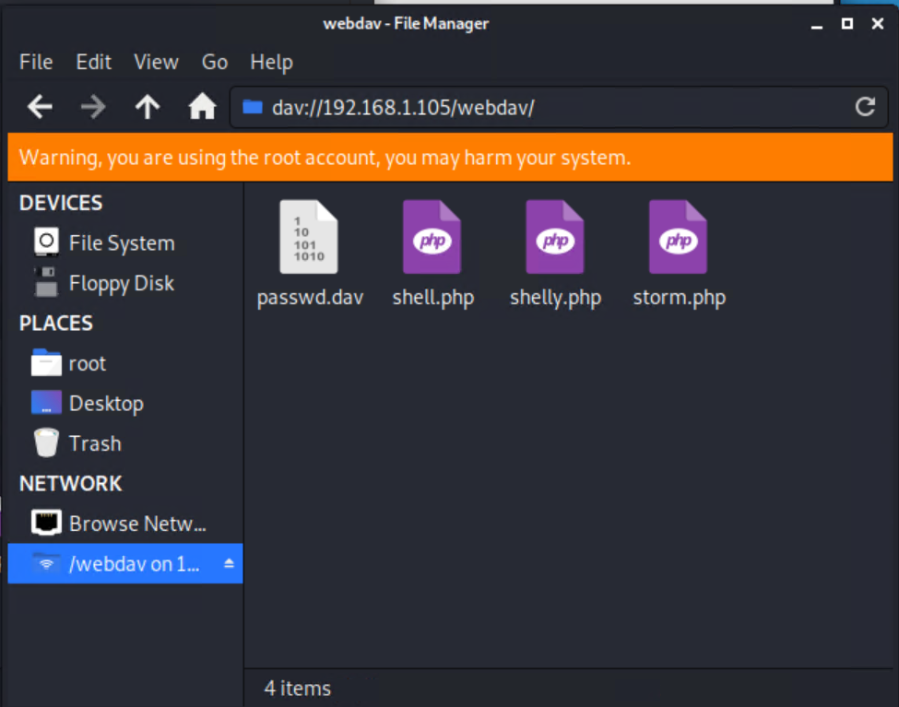
Exploitation: Unauthorized File Upload
01
02
03
Tools & Processes
While connecting to the remote machine with the credentials gathered in the brute force attack. The attacker was able to upload the malicious file through the webdav protocol.
Achievements
The exploit allowed a remote reverse shell script to be installed on the host server which provides the attacker access to multiple vectors of attack.

Slide 12
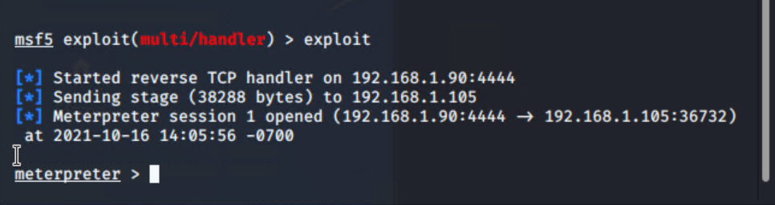
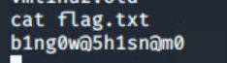
Exploitation: Remote Code Execution
01
02
03
Having permission to upload files into the web server the team was able to upload a malicious file that opened the system to a remote connection.
This malicious file is a listener that allows the team to access the web server remotely from our kali linux machine via reverse shell.
This gave team access to view files such as the flag.txt file seen below.

Slide 13

Blue Team
Log Analysis and Attack Characterization
‹#›

Slide 14
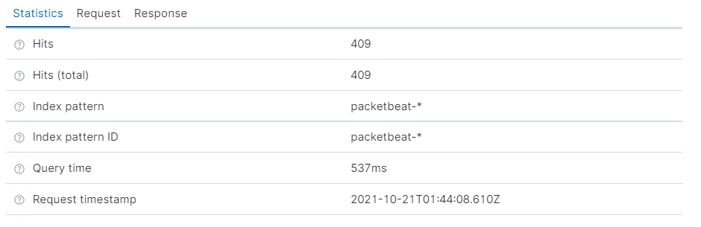

Analysis: Identifying the Port Scan
The port scan began on Oct 16, 2021 @ 16:56:10.013
There were 409 packets sent from 192.168.1.90
All of the different packets were attempting to connect to different ports on the same systems which indicates a port scan.
Notes:
The scan began late on the 16th, the traffic had the tag from the noted linux machine at 192.168.1.90 Ip address.
There

Slide 15
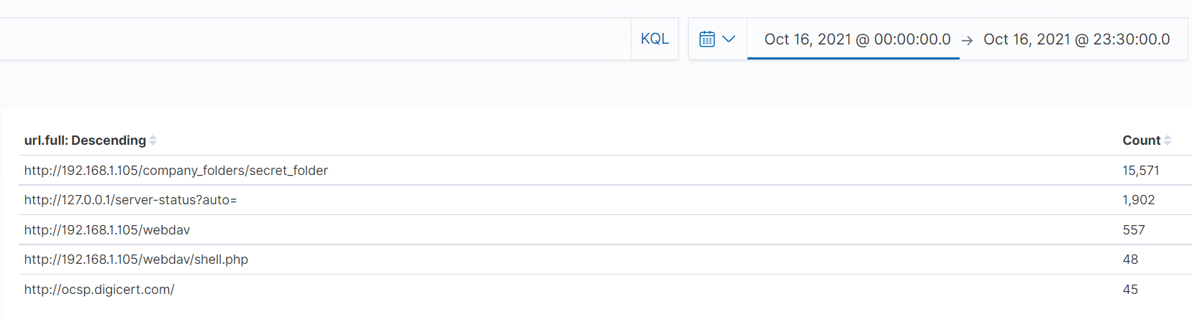
Analysis: Finding the Request for the Hidden Directory
October 16th at 17:23:00
The secret_folder contained inside the company_folder on the company server was accessed
There was a file inside of this folder which contained directions to access the companies webdav server and includes an easily decipherable password for the CEO, Ryan
This folder was protected only by a simple password

Slide 16
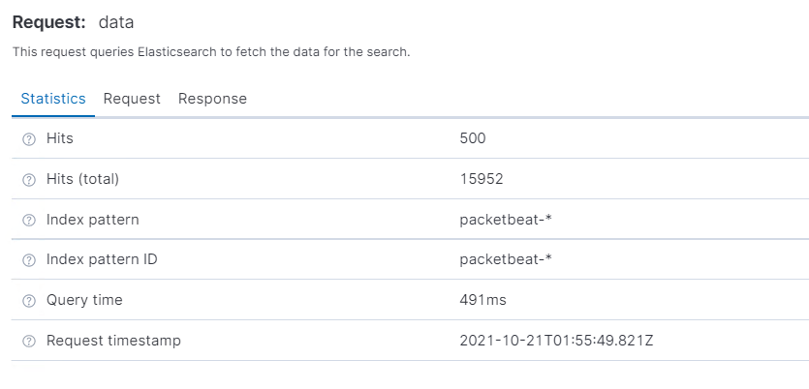
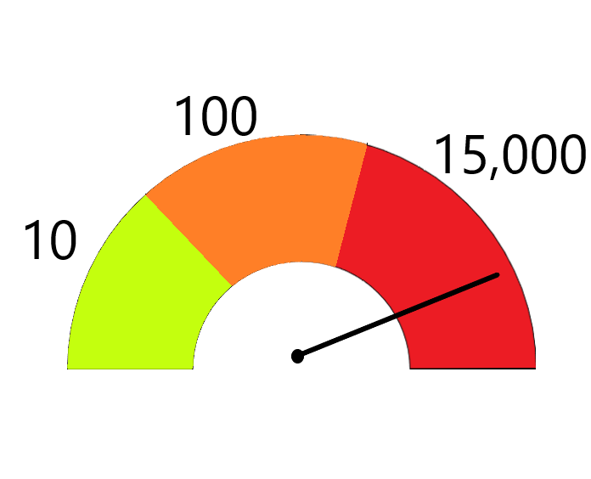
Analysis: Uncovering the Brute Force Attack
There were 15,952 requests made to access the directory /compay_folders/secret_folder/
There were 15,948 failed requests until the response code was “ok”

Slide 17
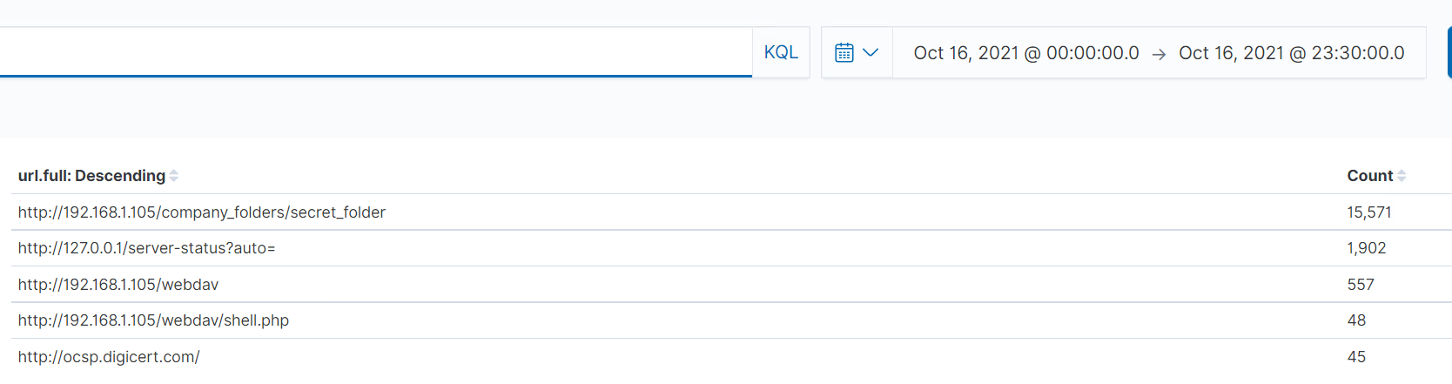
Analysis: Finding the WebDAV Connection
October 16th at 17:45:00
Logs show the webdav folder was accessed
Also a script called shell.php was accessed

Slide 18
Blue Team
Proposed Alarms and Mitigation Strategies
‹#›

Slide 19
Mitigation: Blocking the Port Scan
What kind of alarm can be set to detect future port scans?
Set an alarm for connections per minute. This would trigger when there are multiple connections attempting to go through many different ports in quick succession.
What threshold would you set to activate this alarm?
The threshold would be set to no more than 50 connections every minute as the average seemed to be around 20-35.
What configurations can be set on the host to mitigate port scans?
Disable the ability for the host to reply to ICMP requests, and disable all unnecessary ports.
TCP wrappers which will allow the admin to permit or deny access to these services
Describe the solution. If possible, provide required command lines.
Within the iptables you can configure the network adapter to drop all packets marked as ICMP packets.
Iptables -A INPUT -p icmp -j DROP

Slide 20
Mitigation: Finding the Request for the Hidden Directory
What kind of alarm can be set to detect future unauthorized access?
An alarm that goes off for any machine that attempts to access this directory or file.
What threshold would you set to activate this alarm?
Have white listed IP’s allowed to access this file. Any other IPs accessing should trigger alarm
What configuration can be set on the host to block unwanted access?
A WAF (web application firewall) could be setup to sanitize and remove any requests for any backend directories.
Describe the solution.
This directory and file should be removed from the server all together.

Slide 21
Mitigation: Preventing Brute Force Attacks
What kind of alarm can be set to detect future brute force attacks?
Alerts for when the http return code “401: unauthorized”, for failed password attempts, exceed 25/hr. This would trigger only when a incorrect password is being excessively input.
What threshold would you set to activate this alarm?
Alarm activates when 25 failed attempts in an hour across all users occurs. To account for multiple users being targeted.
What configuration can be set on the host to block brute force attacks?
A lockout protocol that would only allow a certain amount of attempts at a successful login.
Also , enforcing a strong password policy can slow down these attacks.
Eg. Contains both uppercase and lowercase characters. Contains digits and punctuation characters
Describe the solution.
Set a user login limit of 5 unsuccessful attempts before a lockout from login attempts occurs.

Slide 22
Mitigation: Detecting the WebDAV Connection
What kind of alarm can be set to detect future access to this directory?
An alarm to alert of any machine trying to access http://192.168.1.105/webdav other than whitelisted machines, pre-approved access.
What threshold would you set to activate this alarm?
Any unauthorized machines accessing this data should sound an alarm
What configuration can be set on the host to control access?
Firewall rules could be put in place to limit access to this shared folder
Alt. It could made not accessible from the web interface in the first place
Do not keep directions for accessing the WebDAV connection in a plain text file on web server
Describe the solution.
Whitelist IP addresses to machines that would need to access this information
Store this file in an internal, non internet facing, virtual machine behind a firewall

Slide 23
Mitigation: Identifying Reverse Shell Uploads
What kind of alarm can be set to detect future file uploads?
A HTTP “PUT” request alarm could be triggered when coming from an external IP address or a unauthorized device.
Alert for any traffic over port 4444
Alert for any .php file that uploaded to the server
What threshold would you set to activate this alarm?
For internal and trusted devices a threshold of 30 per minute. While external/untrusted devices at 1 to trigger at any traffic that is not allowed.
What configuration can be set on the host to block file uploads?
Server file uploads through HTTP can be disabled by modifying the PHP file directly within the SQL server.
Describe the solution. If possible, provide the required command line.
Within the php.ini file on the system, add in the following command.
file_uploads=off

Slide 24

End of Report
This has been a presentation by Room 3
200|\/| 3 |=02 7|-|3 \/\/1|V

